Slide 1
Reinforcement Learning for Inventory Optimization
Larry Snyder
Professor, Industrial and Systems Engineering
Director, I-DISC
RL for Operations Summer Bootcamp
Northwestern University, Aug. 18, 2022

Slide 2
RL for the Multi-Period Newsvendor Problem
Part 3

Slide 3
RL for the MPNV
It’s pretty fast to solve the MPNV as an MDP
But MDP requires us to know the dynamics (transition probabilities and rewards)
But for other inventory problems (like the beer game problem), we don’t know the dynamics
We’ll need RL for those problems
So let’s try it for the much simpler MPNV

Slide 4
RL for the MPNV
We’ll use tabular methods to solve the MPNV
For the coding portion, you can use my code for Q-learning, etc., or plug in your own
It’s convenient to use an environment to model the system
The environment needs to simulate the inventory system
stockpyl will do simulation for us
stockpyl’s simulation can reset() and step()
But it’s not exactly an “environment”
Our environment is like a wrapper for stockpyl’s simulation

Slide 5
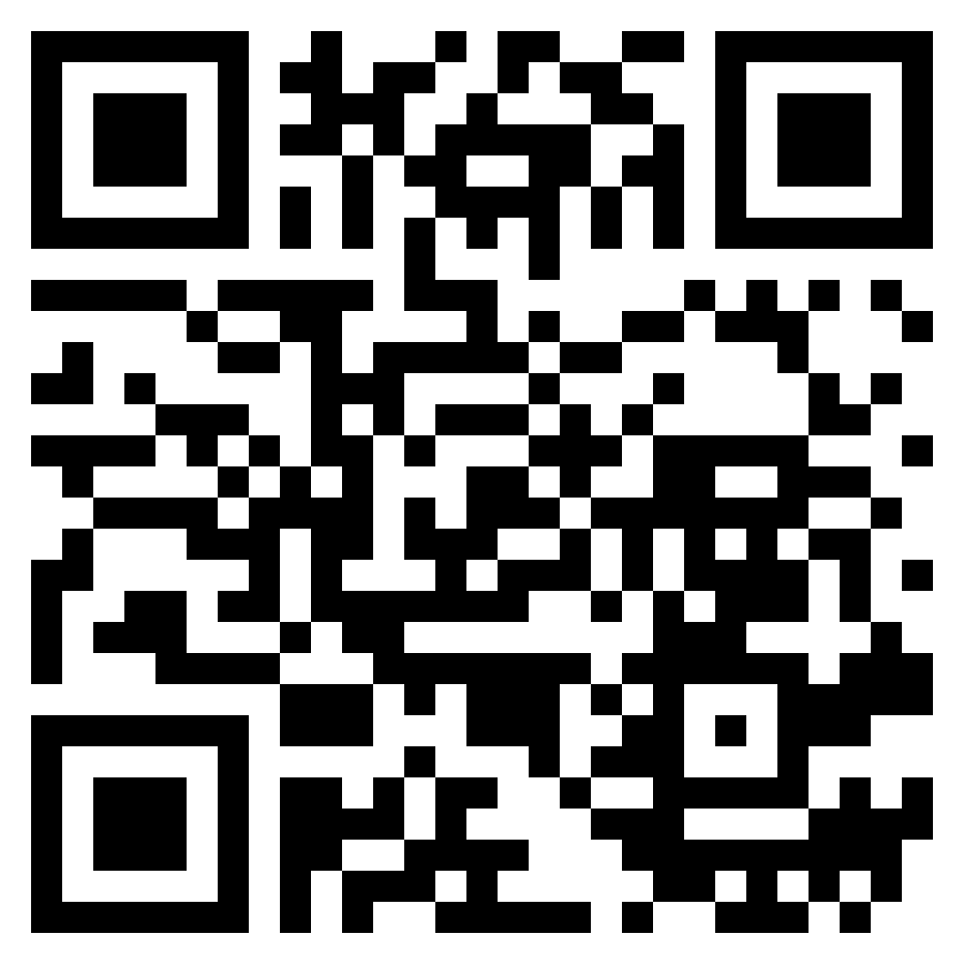
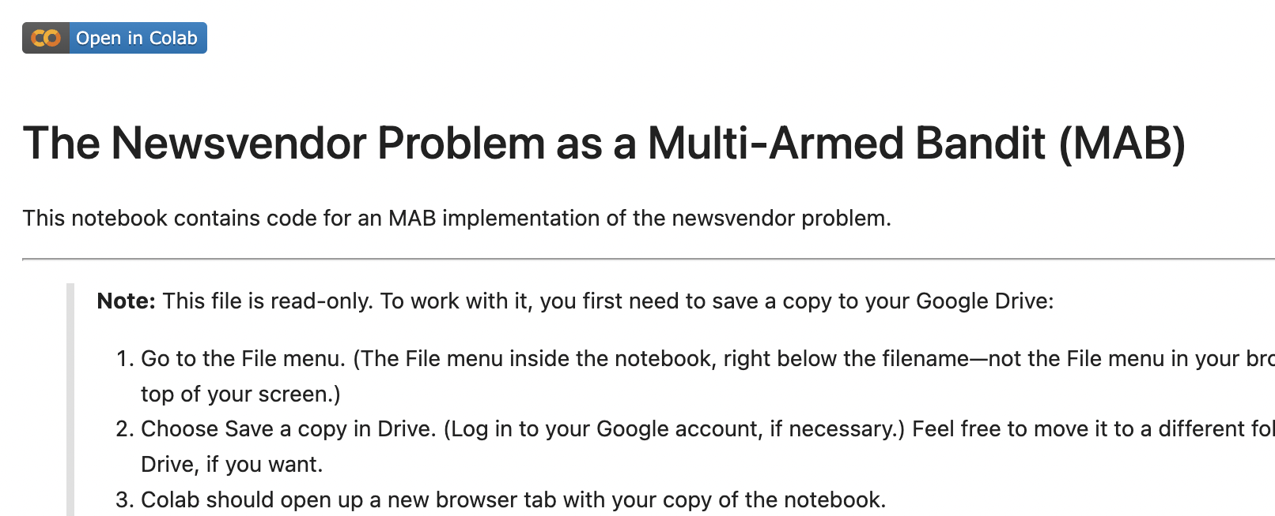
Coding time!
Go to github.com/LarrySnyder/RLforInventory
Click notebooks
Click 3: RL for MPNV.ipynb
Click the “Open in Colab” button:
Follow the directions in the notebook to make your own copy
Work through the notebook at your own pace

Slide 6
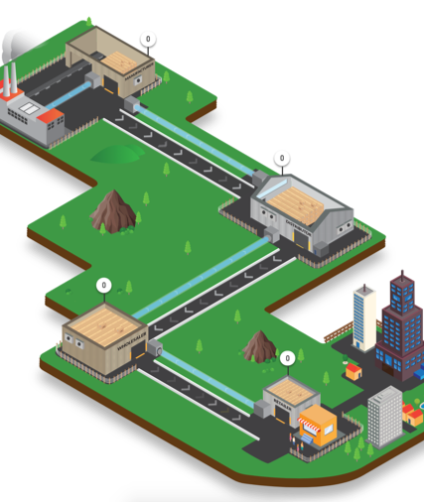

Questions?
larry.snyder@lehigh.edu
https://coral.ise.lehigh.edu/larry/
Supported in part by NSF grants NSF:CCF:1618717, NSF:CMMI:1663256, NSF:CCF:1740796, and XSEDE:DDM180004.

